Slide 1
Ai Agents Revolutionising Chronic Disease Monitoring
CAPSTONE PROJECT
Presented By:
Student name : Mamata Balakatte
College Name & Department : Lovely Professional University, Jalandhar (BTech CSE)

Slide 2
OUTLINE
Problem Statement
Technology used
Wow factor
End users
Result
Conclusion
Git-hub Link
Future scope
IBM Certifications

Slide 3
Problem Statement
Chronic diseases require continuous monitoring, but current methods are reactive, fragmented, and often detect issues too late. The vast, complex data from wearables and health records overwhelms providers, while patients struggle with adherence. AI-powered multi-agent systems can transform this process by analyzing data in real time, predicting risks, and delivering personalized, proactive care.
Proposed Solution: Develop an AI-powered multi-agent system that integrates data from wearables, medical devices, and electronic health records to provide continuous, real-time monitoring of chronic diseases. Each agent will have a specific role—such as vital sign tracking, medication adherence monitoring, and lifestyle coaching—collaborating to predict health risks, alert clinicians, and deliver personalized recommendations to patients. The system will enable proactive interventions, improve patient engagement, and reduce complications through early detection and tailored care.

Slide 4
Technology used
IBM cloud lite services
Natural Language Processing (NLP)
IBM Granite model

Slide 5
IBM cloud services used
IBM Cloud Watsonx AI Studio
IBM Cloud Watsonx AI runtime
IBM Cloud Agent Lab
IBM Granite foundation model

Slide 6
Wow factors
This AI-powered multi-agent system offers unique features such as creating a digital health twin for personalized simulations, specialized agents for tasks like vital monitoring and lifestyle coaching, emotion-aware conversational AI for empathetic engagement, cross-condition monitoring to manage co-morbidities, adaptive learning models that evolve with patient data, proactive emergency escalation to healthcare providers, and gamified health engagement to boost treatment adherence.
Unique Features:
Digital Health Twin – Virtual replica of patient health to simulate disease progression and test interventions.
Specialized Multi-Agent System – Dedicated AI agents for vitals, medication, lifestyle, and risk prediction.
Emotion-Aware Conversational AI – Detects patient mood and adapts responses for better engagement.
Cross-Condition Monitoring – Simultaneous tracking of multiple chronic diseases and co-morbidities.
Adaptive Learning Models – Continuously refine predictions based on patient feedback and new data.
Proactive Emergency Escalation – Alerts doctors or caregivers in high-risk scenarios.
Gamified Health Engagement – Rewards and challenges to improve patient adherence and motivation.

Slide 7
End users
Patients with Chronic Diseases – Individuals managing conditions like diabetes, hypertension, heart disease, kidney disorders, or neurodegenerative illnesses.
Healthcare Providers – Doctors, specialists, and nurses who need continuous patient data for timely interventions.
Hospitals & Clinics – Institutions seeking efficient chronic disease management solutions.
Caregivers & Family Members – Those supporting patients in daily health management.
Health Insurance Companies – For preventive care programs and reducing hospitalization costs.
Public Health Agencies – Monitoring population health trends and planning interventions.

Slide 8
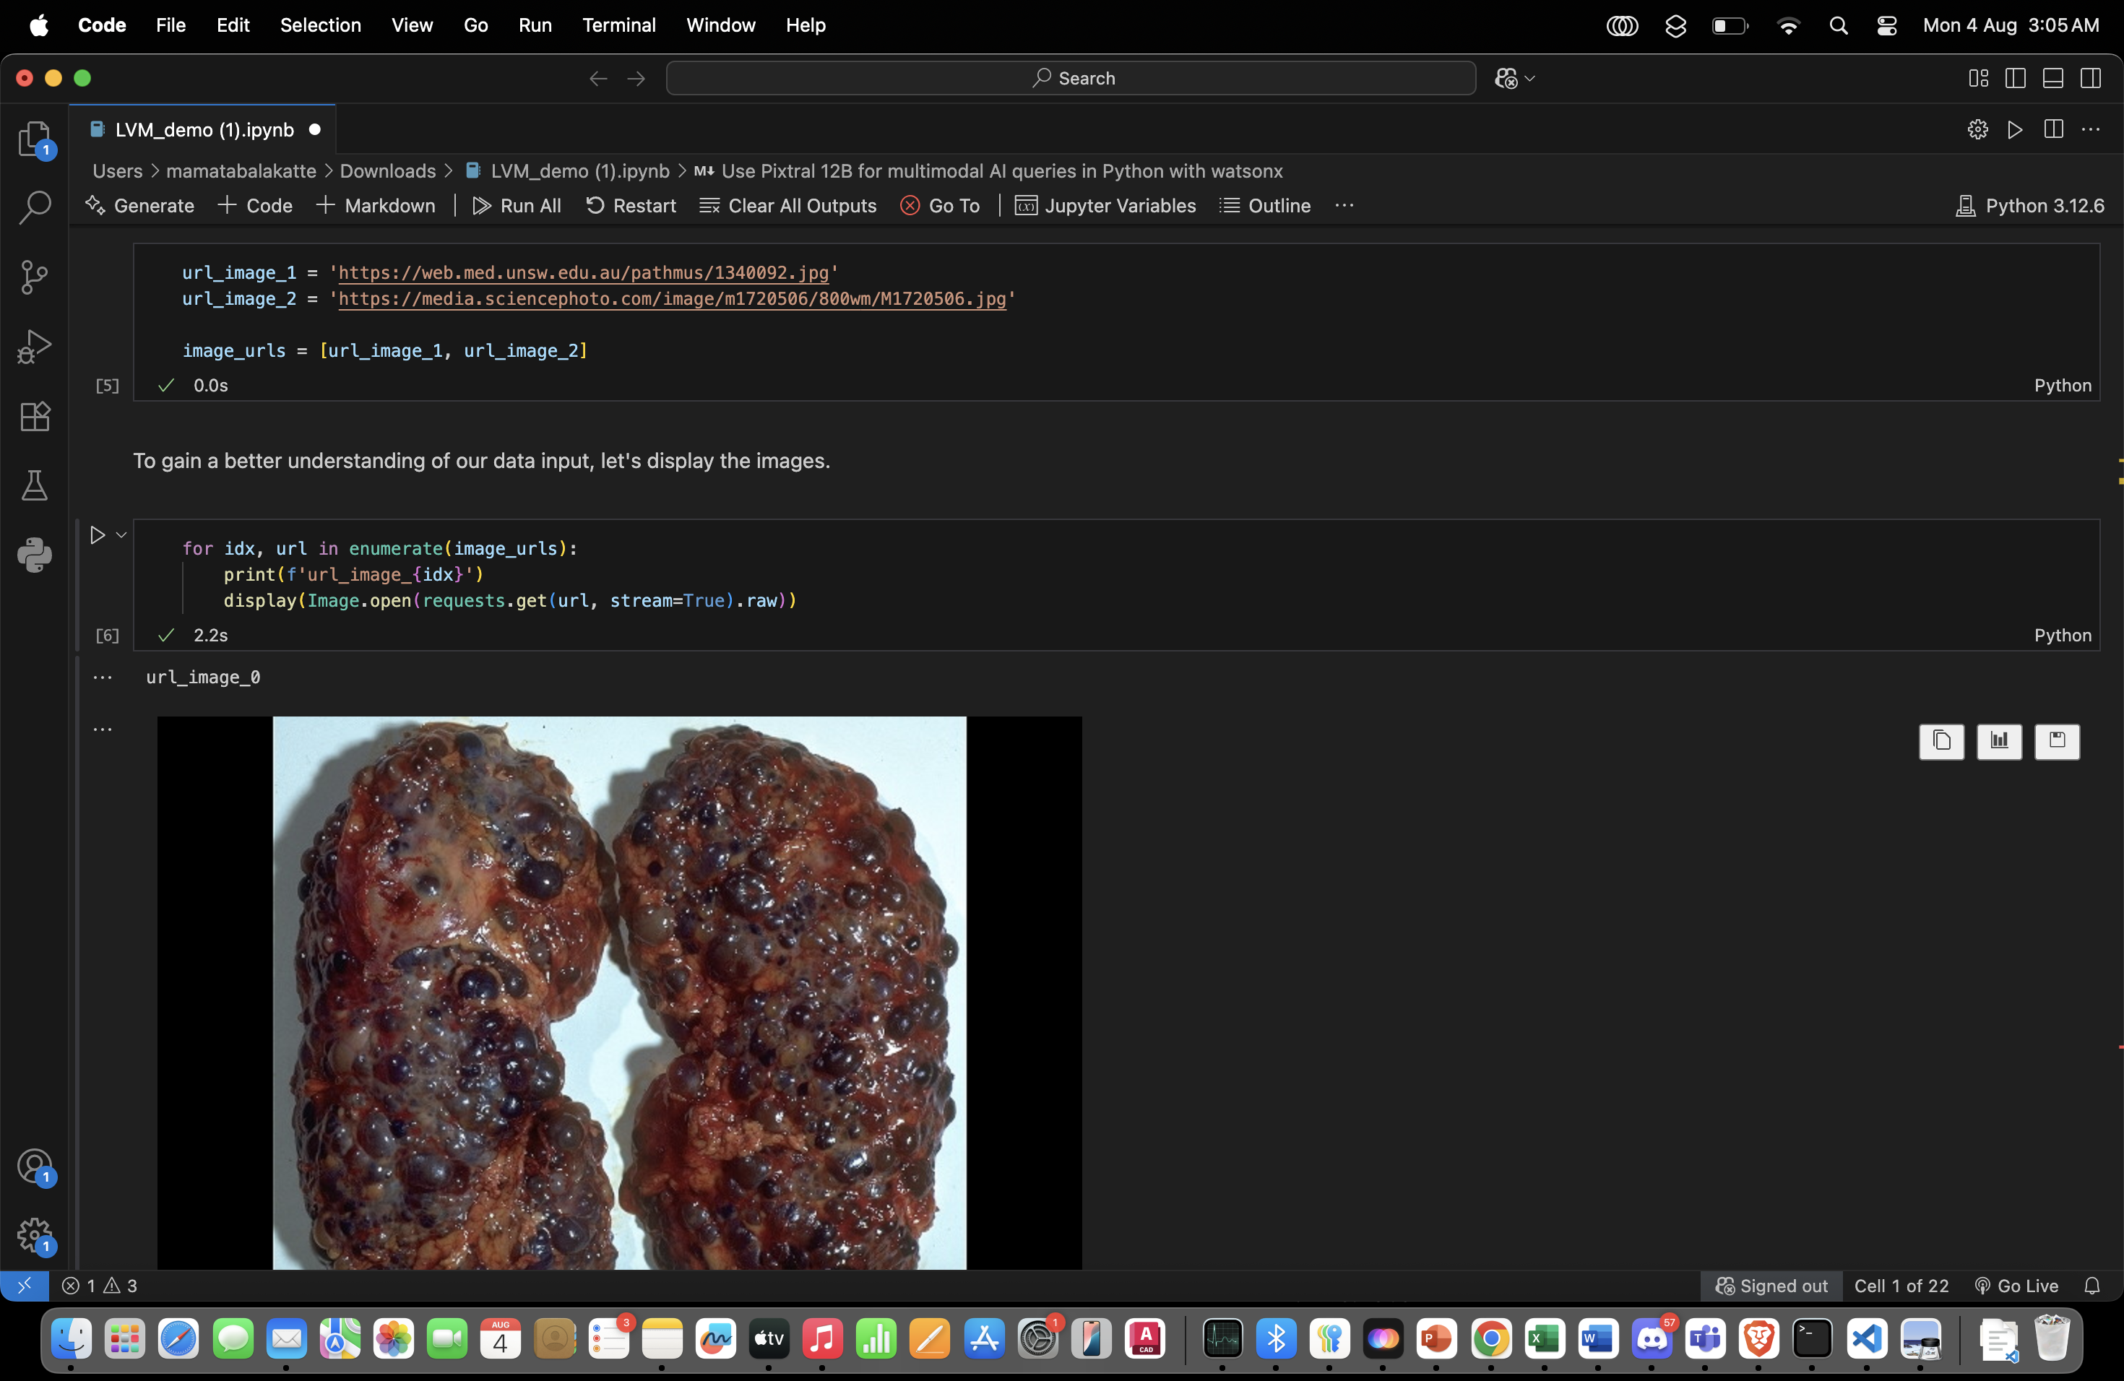
Results

Slide 9
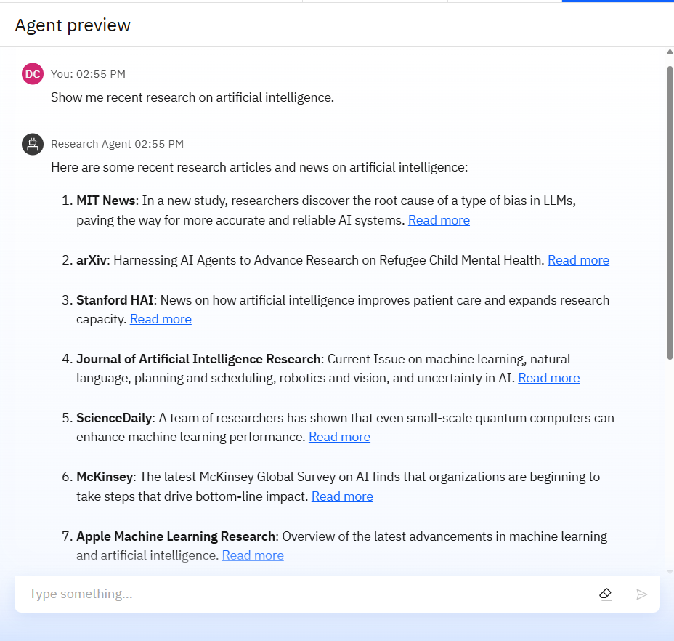
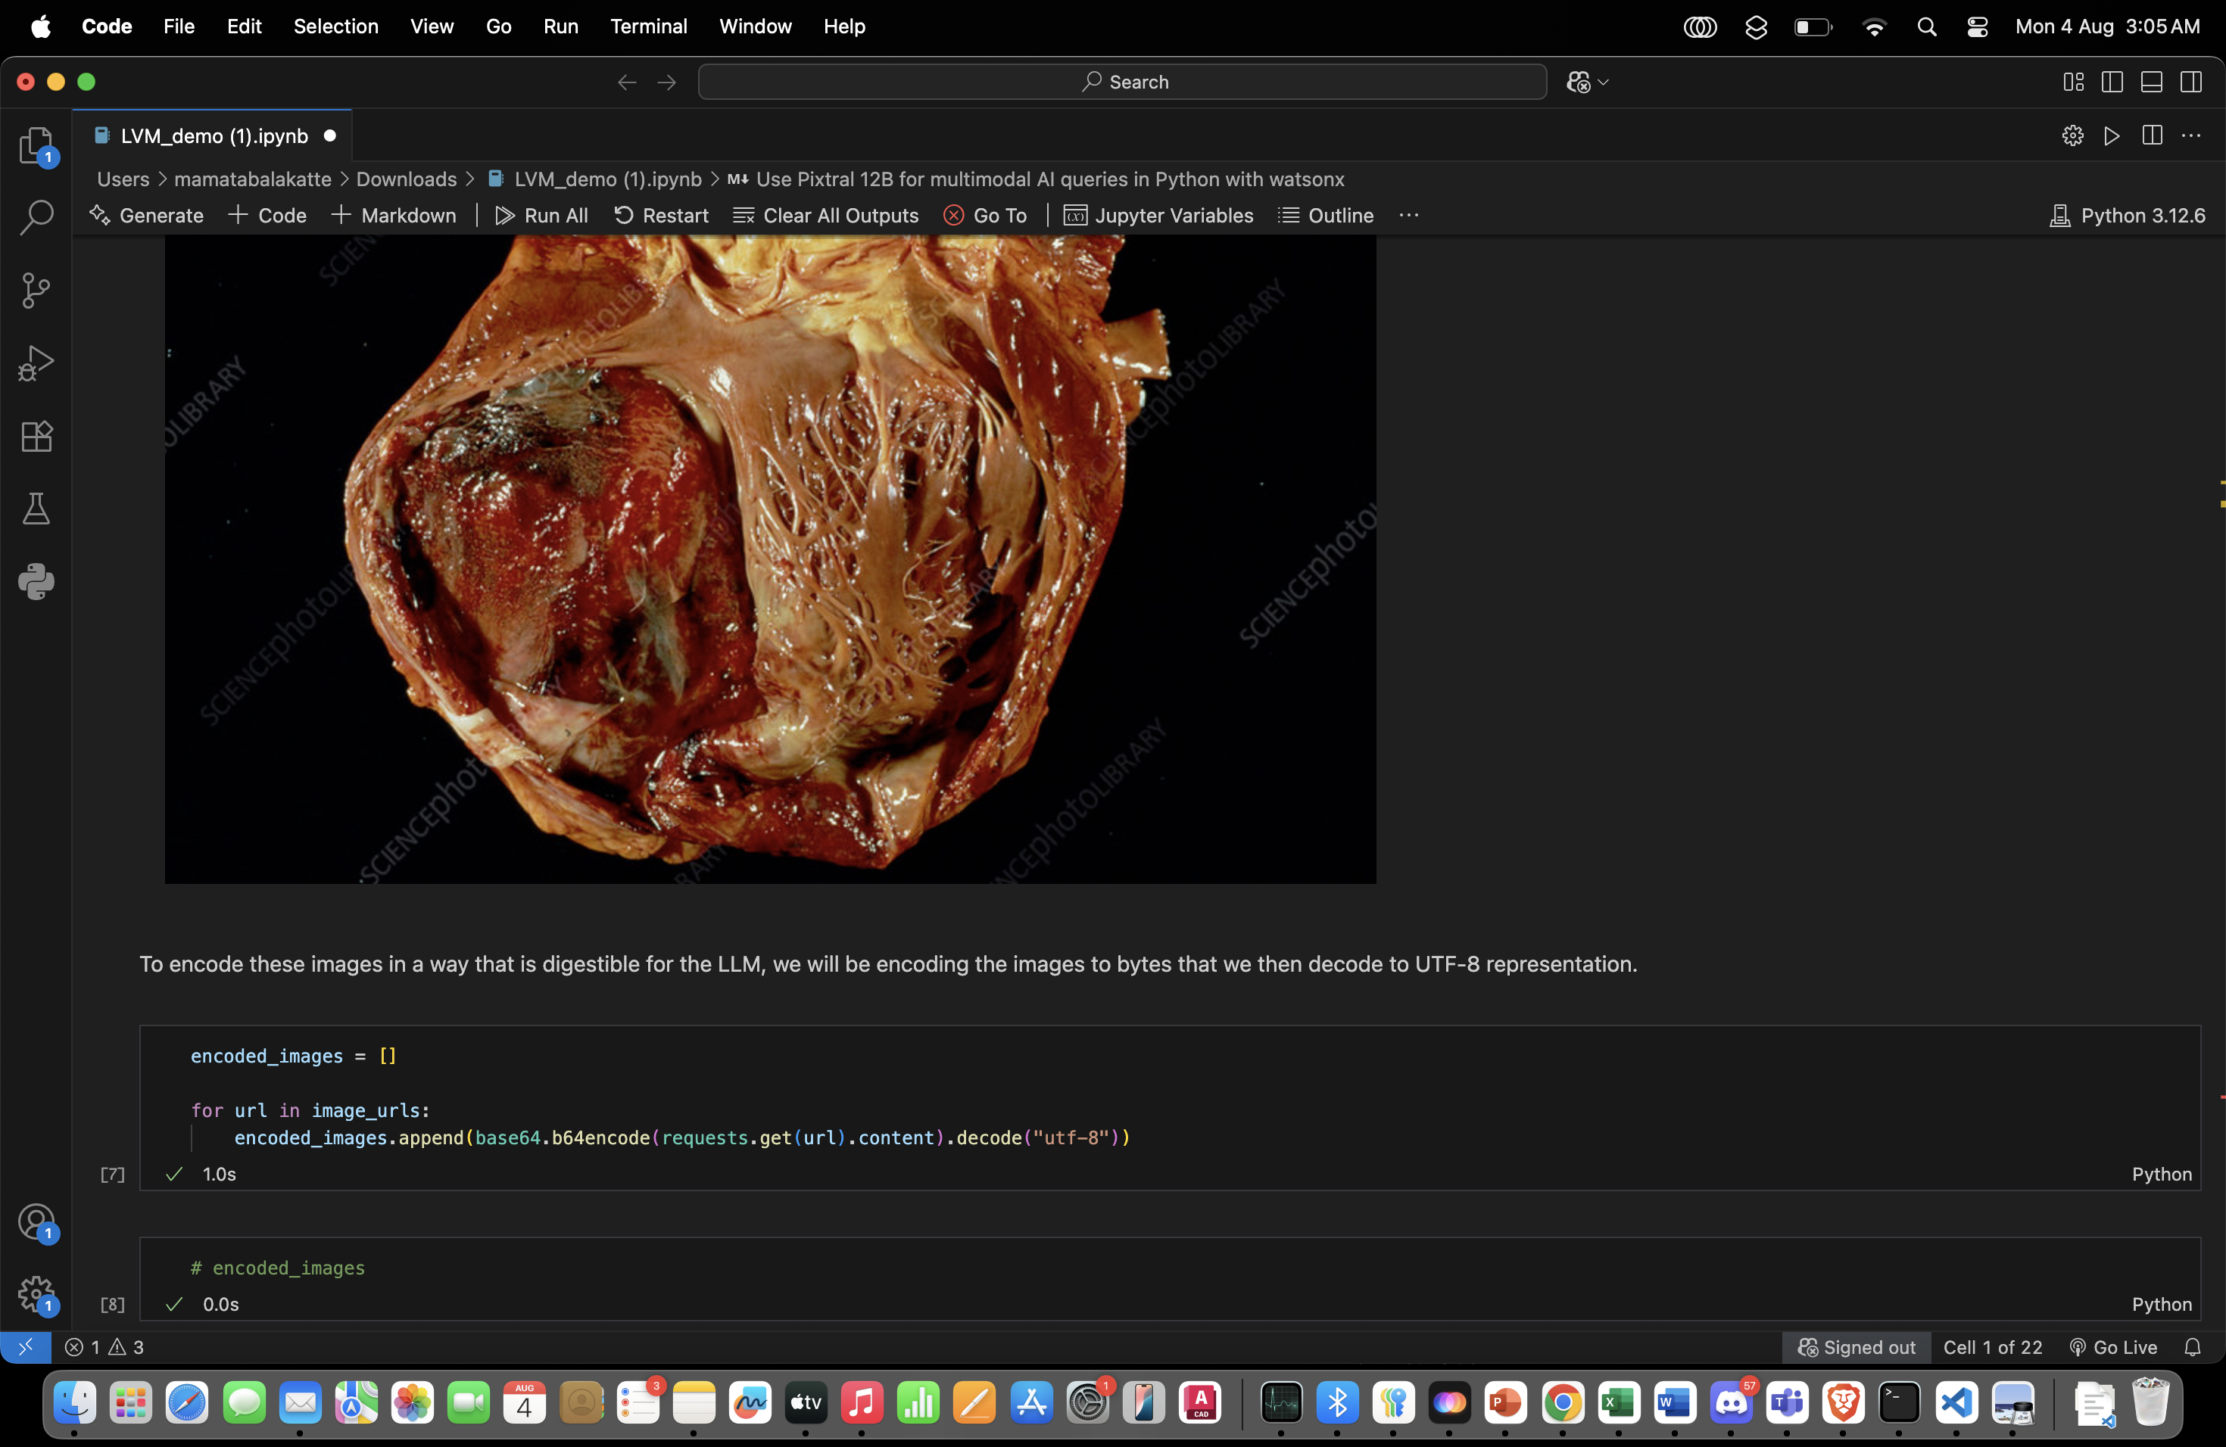
Results

Slide 10
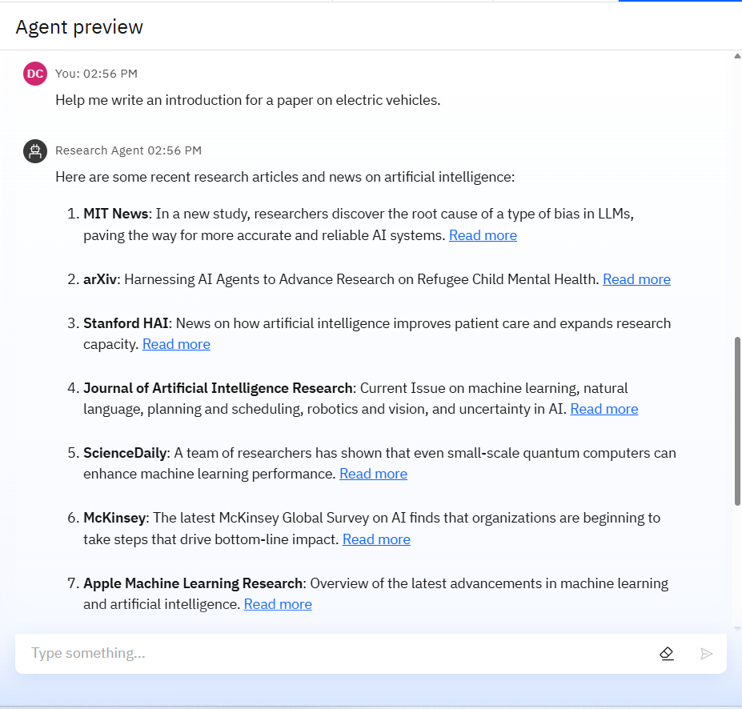
Results

Slide 11
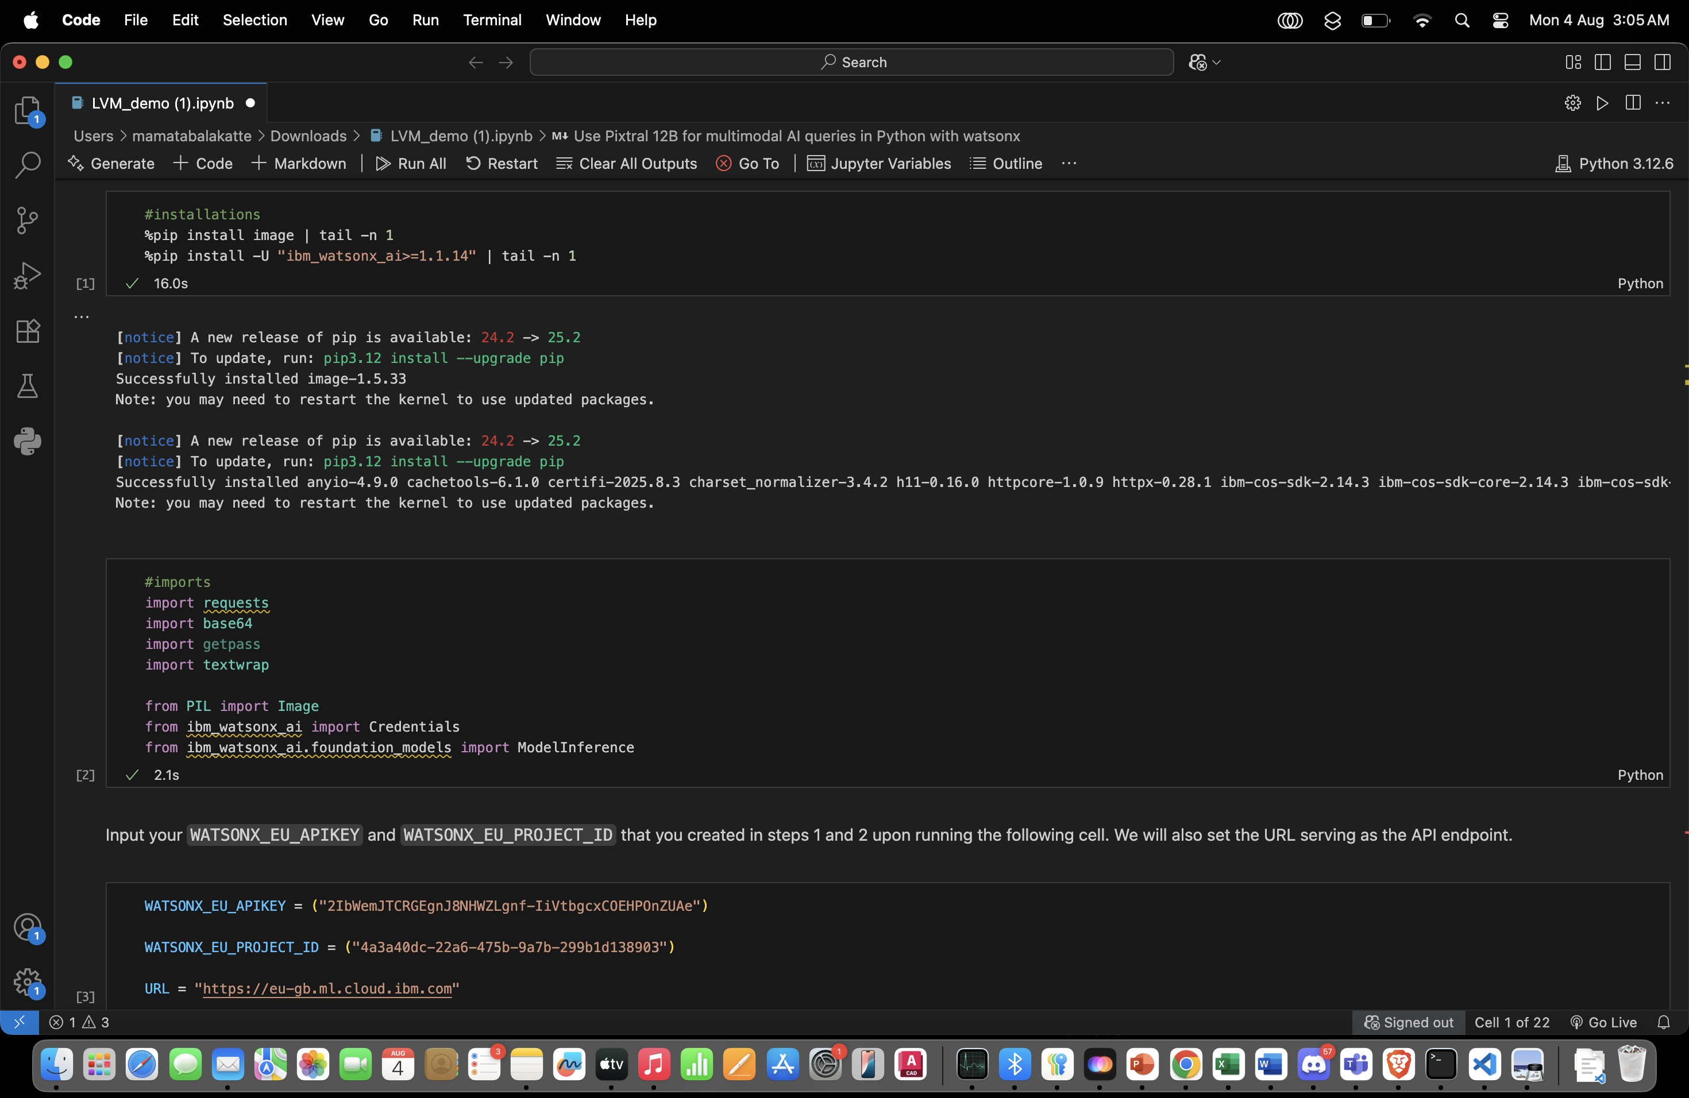
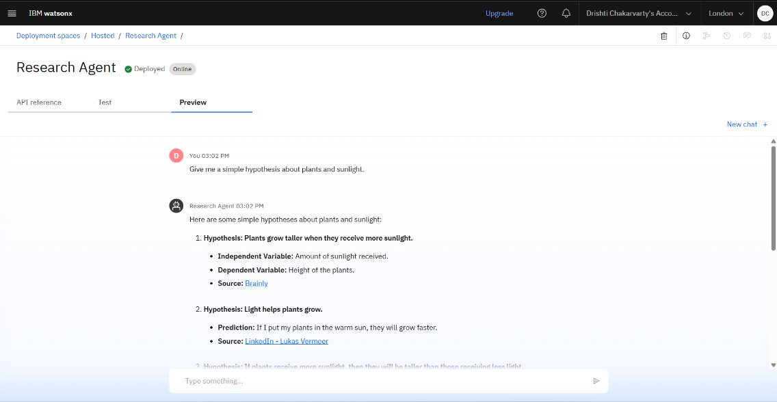
Results
Deployed AI Agent

Slide 12
Conclusion
The proposed AI-powered multi-agent system has the potential to revolutionize chronic disease management by shifting care from reactive to proactive. Through continuous monitoring, predictive analytics, and personalized interventions, it empowers patients to better manage their health, supports healthcare providers with actionable insights, and reduces the burden on medical systems. By integrating advanced AI, IoT, and secure cloud technologies, this solution not only enhances clinical outcomes but also improves quality of life—paving the way for a smarter, more connected future in healthcare.

Slide 13
Future scope
Integration with Genomic & Biomarker Data – Enable precision medicine by tailoring interventions to a patient’s genetic profile.
Advanced Digital Twins – Create highly detailed simulations that can predict long-term disease trajectories and treatment impacts.
Global Health Network – Connect patients and providers worldwide for collaborative chronic disease management.
AR/VR Health Coaching – Use immersive technologies for patient education and rehabilitation exercises.
Federated Learning Models – Train AI on decentralized patient data without compromising privacy.
Expanded Disease Coverage – Include rare diseases and mental health conditions alongside common chronic illnesses.
Autonomous Care Pathways – AI agents that can autonomously adjust treatment plans within clinician-approved boundaries.

Slide 14
IBM Certifications
Screenshot/ credly certificate( getting started with AI)

Slide 15
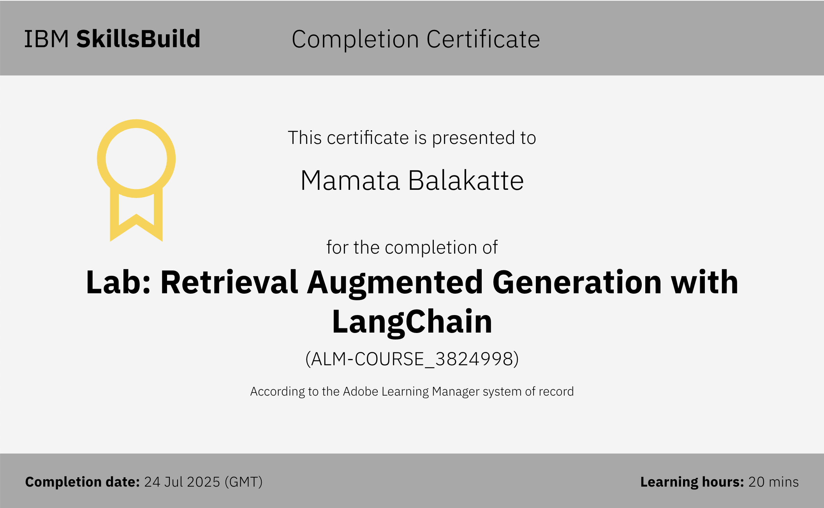
Attach your RAG LAB certificate here

Slide 16
Git hub link : https://github.com/mamatabalakatte/chronicai

Slide 17
GitHub Link
Make sure that there should be readme file

Slide 18
THANK YOU

